Slide 1

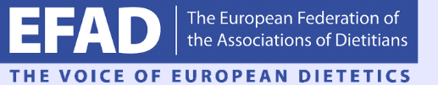
Obesity Guidelines in Europe- Current status
Dr Antonis Vlassopoulos
Agricultural University of Athens
International Hellenic University

Slide 2
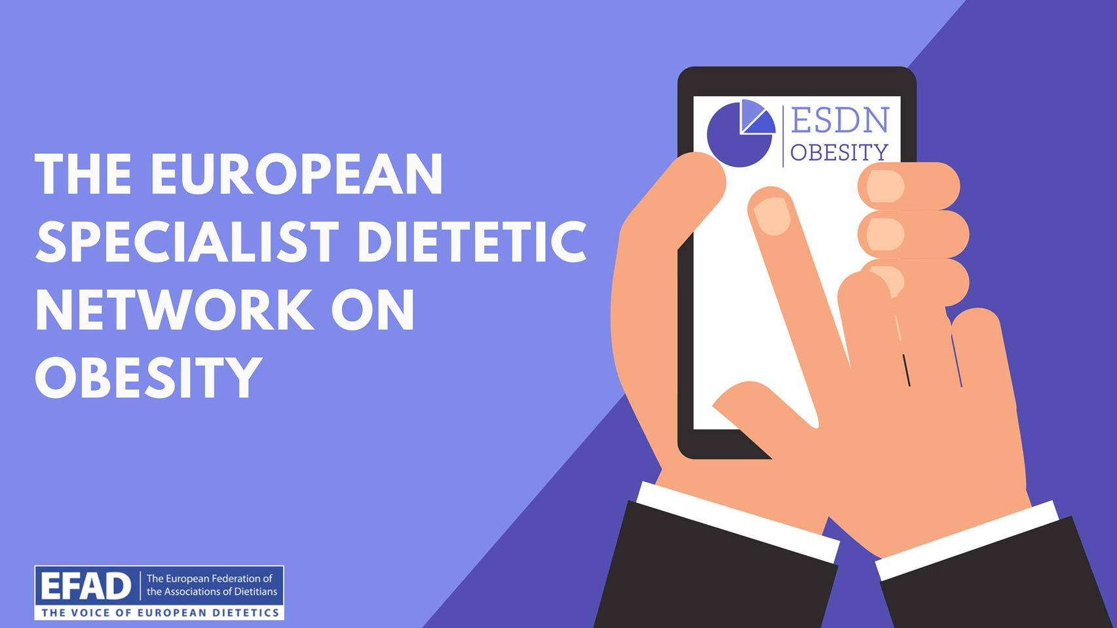
ESDN Obesity
Members
Maria Hassapidou, Chair,
Ellen Govers, Deputy Chair
Hilda Mulrooney
Odysseas Androutsos
Antonis Vlassopoulos
Zeynep Eroglu
Marianna Kalliostra

Slide 3
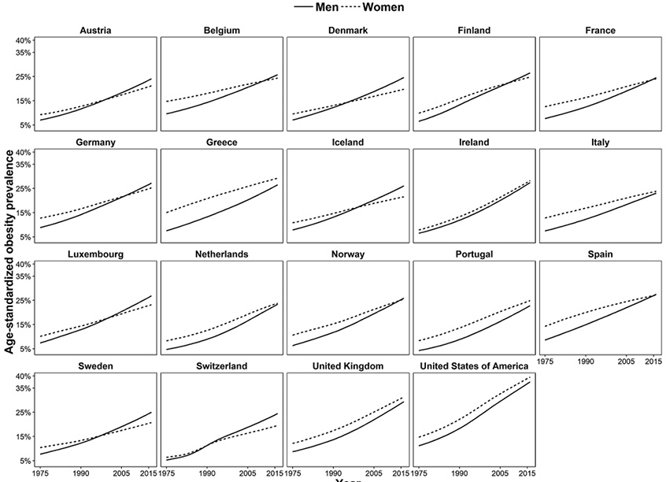
Obesity prevalence on the rise
There are no signs for a reduction in obesity
The issue seems to expanding at a lower speed but the change is still upwards
Janssen F, et al: Obesity Prevalence in the Long-Term Future in 18 European Countries and in the USA. Obes Facts 2020

Slide 4
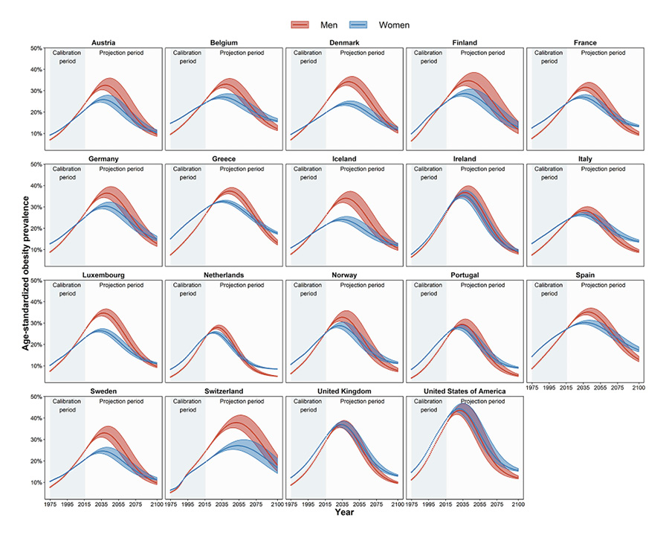
Obesity prevalence on the rise
The obesity epidemic is projected to peak in 2035
Surpassing the 30% prevalence esp. for men
Janssen F, et al: Obesity Prevalence in the Long-Term Future in 18 European Countries and in the USA. Obes Facts 2020

Slide 5
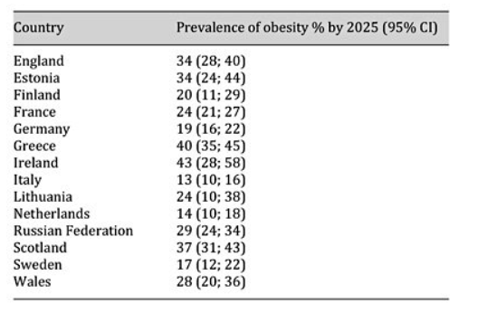
Obesity treatment the highest ranking issue
Approximately ¼ of Europe will need to consider obesity interventions in the coming 4 years
Prevention is crucial to flatten the curve
Treatment will be the top public health priority in most countries
Pineda E, Sanchez-Romero L, M, Brown M, Jaccard A, Jewell J, Galea G, Webber L, Breda: Forecasting Future Trends in Obesity across Europe: The Value of Improving Surveillance. Obes Facts 2018;11:360-371.

Slide 6


Background
In 2014 EFAD together with EASO committed to creating the 1st European Guidelines for the Treatment of Obesity
To understand the current needs for European Dietitians
Review the existing literature
Provide policy makers and health care professionals with a consensus document to be used equally by all member states.

Slide 7
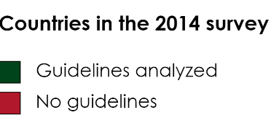

Methods
ESDN Obesity carried out 2 survey among European Dietitians
1st Survey (December 2014) contacted all EFAD NDAs
The latest national Obesity treatment Guidelines
Aim
To compare the available guidelines for the dietetic treatment of obesity

Slide 8
Overview of Obesity Guidelines
Vlassopoulos, A., Govers, E., Mulrooney, H. et al. Dietetic management of obesity in Europe: gaps in current practice. Eur J Clin Nutr (2021).

Slide 9
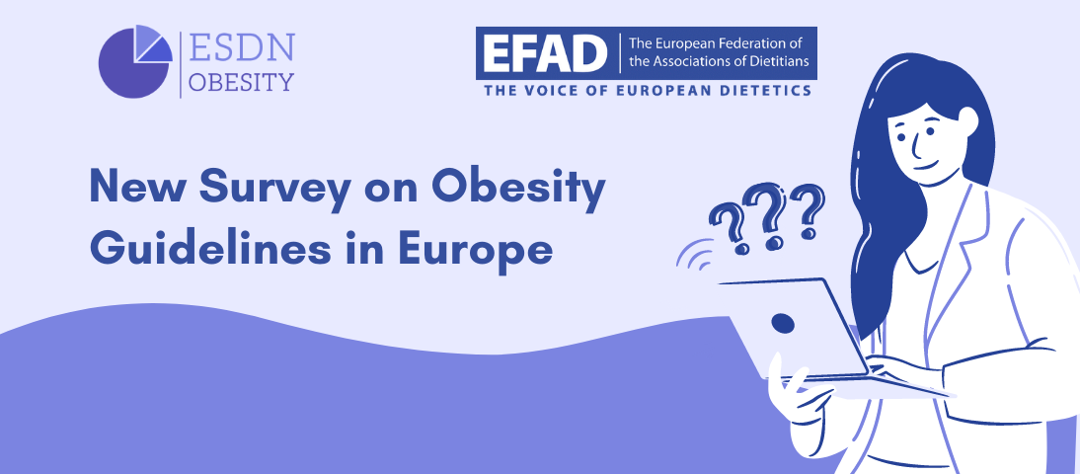
Methods
ESDN Obesity carried out 2 survey among European Dietitians
2nd Survey (December 2016) included 185 responses from 22 countries
Aim
To analyse the current practices employed by dietitians when dealing with obesity

Slide 10
Descriptive Statistics
65% took additional training specific for the treatment of obesity

Slide 11
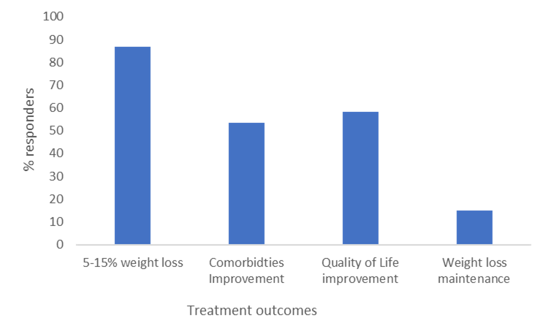
What treatment outcomes are employed?
Vlassopoulos, A., Govers, E., Mulrooney, H. et al. Dietetic management of obesity in Europe: gaps in current practice. Eur J Clin Nutr (2021).

Slide 12
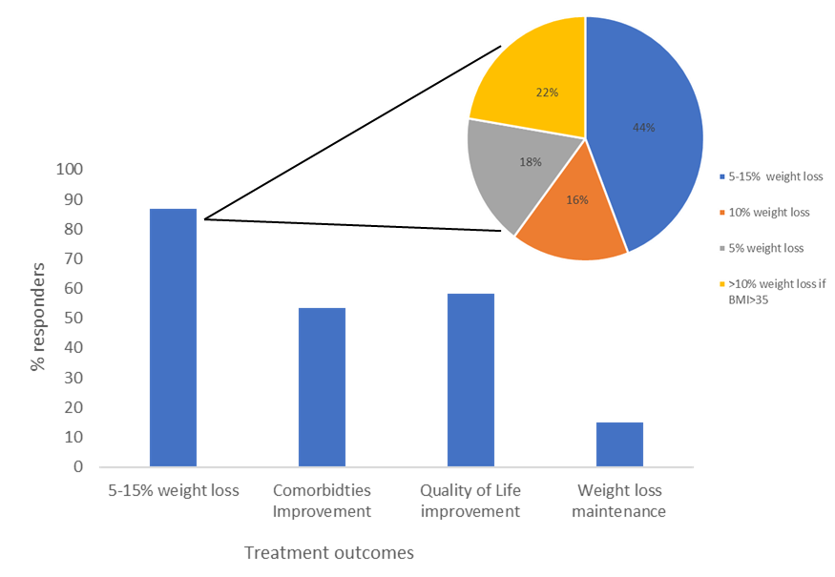
What treatment outcomes are employed?
Vlassopoulos, A., Govers, E., Mulrooney, H. et al. Dietetic management of obesity in Europe: gaps in current practice. Eur J Clin Nutr (2021).

Slide 13
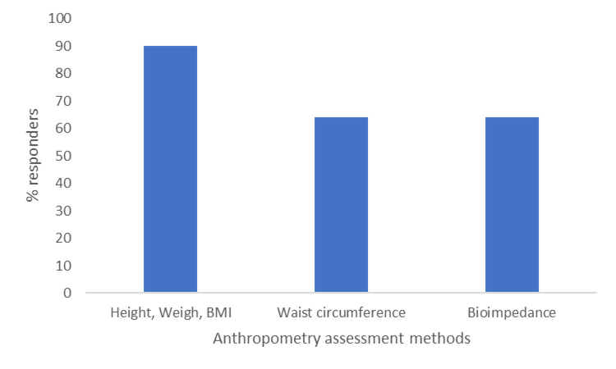
How is anthropometry assessed?
Body composition measured in 64% 0f cases
Vlassopoulos, A., Govers, E., Mulrooney, H. et al. Dietetic management of obesity in Europe: gaps in current practice. Eur J Clin Nutr (2021).

Slide 14
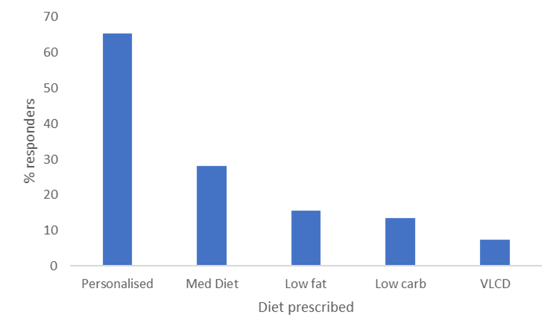
Which is the most common diet prescribed?
Personalized advice is the most commonly employed practice
Vlassopoulos, A., Govers, E., Mulrooney, H. et al. Dietetic management of obesity in Europe: gaps in current practice. Eur J Clin Nutr (2021).

Slide 15
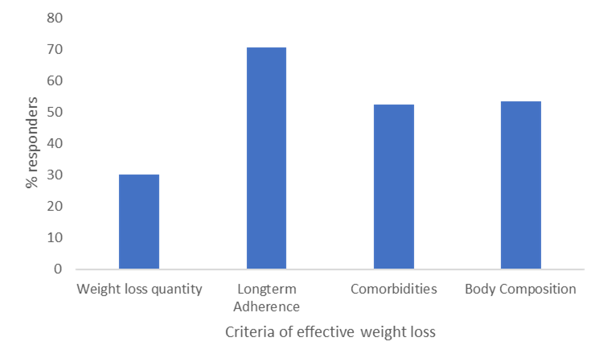
How is success defined?
Focus on maintenance and long-term adherence
Changes in body composition and improvement of comorbidities
Vlassopoulos, A., Govers, E., Mulrooney, H. et al. Dietetic management of obesity in Europe: gaps in current practice. Eur J Clin Nutr (2021).

Slide 16
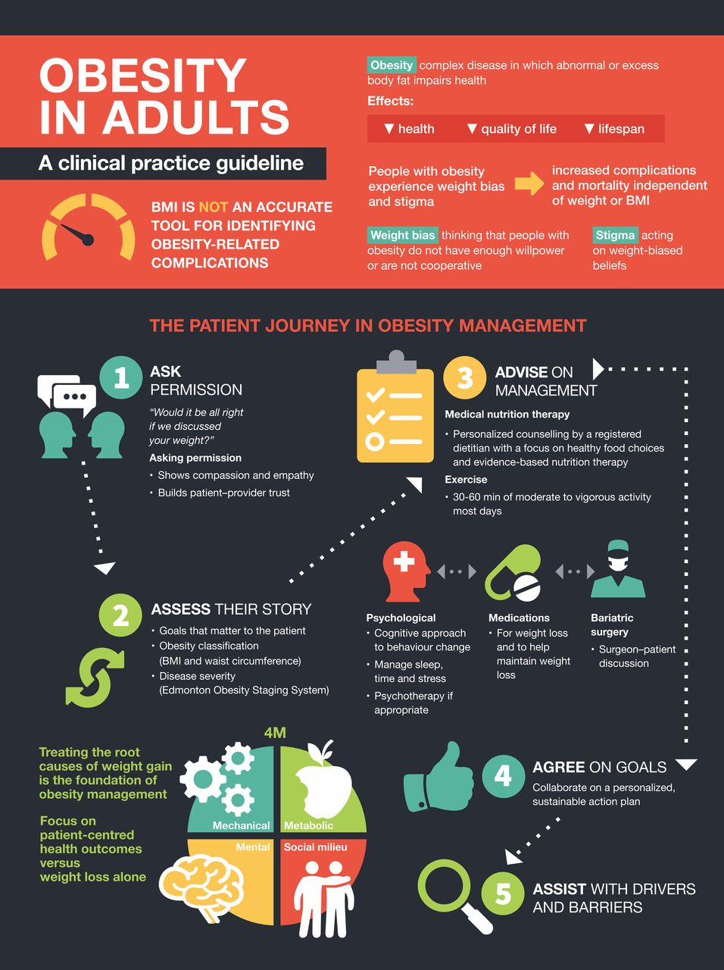
The case of Canada
Dietetic guidelines in obesity management nowadays go beyond simple guidance for intensive lifestyle interventions
Sean Wharton, et al, Obesity in adults: a clinical practice guideline, CMAJ Aug 2020, 192 (31) E875-E891; DOI: 10.1503/cmaj.191707

Slide 17
The case of Canada
Obesity treatment is a patient centric journey
It is created by patients for patients
Needs SMART evidence based goals

Slide 18
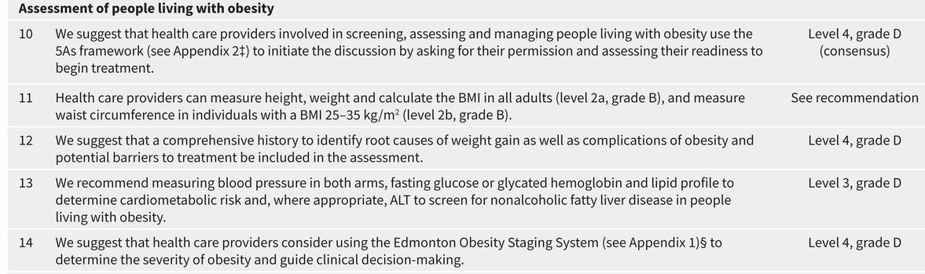
Don’t aim for fancy but for effective
Simple anthropometry is still the best practice available
Use it more often and systematically
Sean Wharton, et al, Obesity in adults: a clinical practice guideline, CMAJ Aug 2020, 192 (31) E875-E891; DOI: 10.1503/cmaj.191707

Slide 19
Are we propagating stigma?
Consider the level of pressure employed and the promotion of body standards
Do we propagate stigma among our profession?
Is the avoidance of anthropometry stigma in disguise?
Sean Wharton, et al, Obesity in adults: a clinical practice guideline, CMAJ Aug 2020, 192 (31) E875-E891; DOI: 10.1503/cmaj.191707

Slide 20
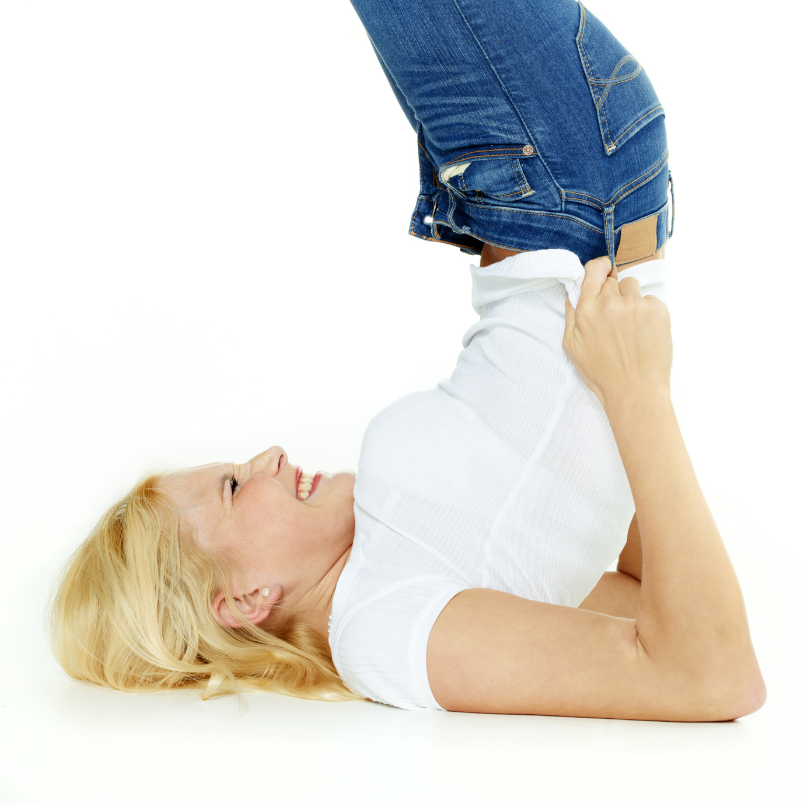
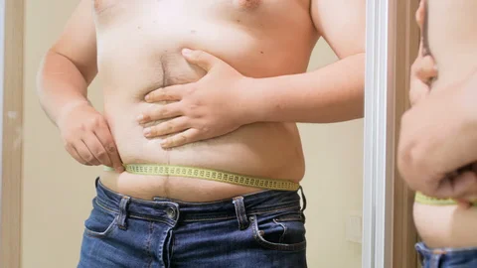
Circumferences are a great self-assessment tool
Stigma and internalized bias in body image perception is part of our daily life
We should use those moments as an opportunity to reward ourselves
Transform them into self assessment rather than a moment of shame

Slide 21

Key take away thoughts
Dieticians are highly skilled professionals who tend to closely follow guidelines
Although evidence based practice is part of our curriculum, weight loss and obesity treatment is rarely met with clear SMART guidelines
Obesity is often mentioned in the context of prevention but treatment is often described under the generic term ‘personalized approaches’
There is lack of clear consensus on which dietary protocols are more suitable for obesity interventions
Weight maintenance is considered by dieticians as a key success factor but guidelines do not include it
Anthropometry especially circumferences are under utilized. Is that indication of stigma, shame and should how should we employ anthropometry?

Slide 22
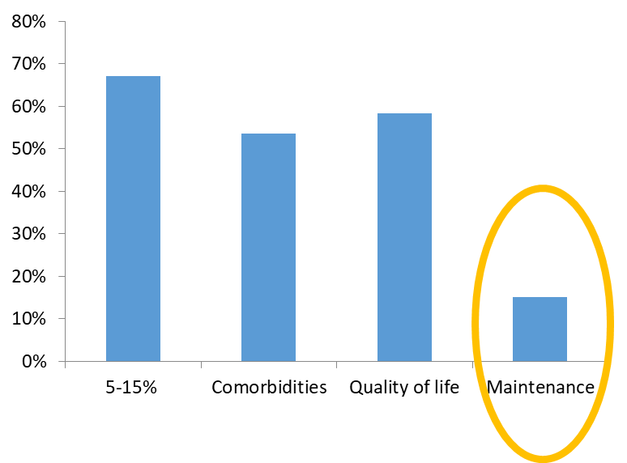
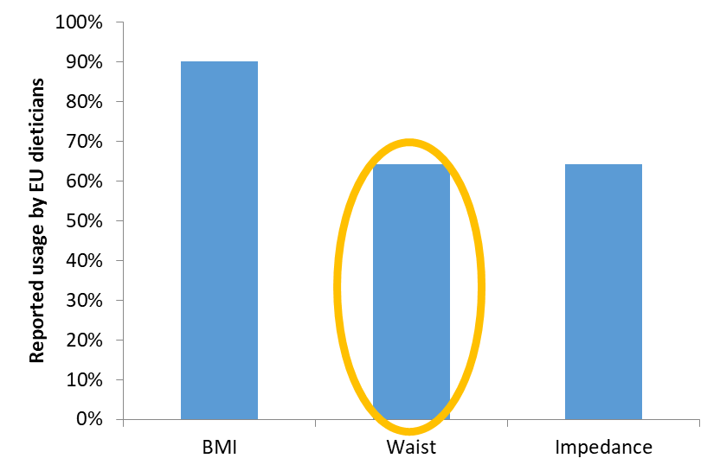
What are the guideline gaps?
Why are we afraid to talk about maintenance and employ it as a goal?
Why do we avoid the issue of circumferences?
Do we know what the best mix of evidence based practice and experience is needed to truly create a personalized diet?

Slide 23
Strengthen the existing knowledge
Evidence Strength | Diet & Obesity treatment
Strong | 5-10% weight loss over 6 months is realistic and with a proven health benefit Reduce BP Improve LDL and HDL cholesterol Large improvements in TG and blood glucose Reduce the need of medication
 | Lifestyle interventions based on patient’s preferences, health status by nutrition professionals
 | Promote long-term success by prescribing diets based on cultural preferences (e.g. Mediterranean / Nordic diet)
 | Promote the increase of physical activity and discuss its usefulness for maintenance
 | Prescribe 600 kcal/d energy deficit Can reach 750-1000 kcal/d based on weight status 1200-1500 kcal/d 1500- 1800 kcal/d

Slide 24
Utilize more of these…
Evidence Strength | Diet & Obesity treatment
Strong | Even reductions as small as 3-5% are clinically meaningful Triglycerides - Blood glucose HbA1c - Risk of developing T2DM
 | Focus on changes in Body Composition Waist Circumference and Fat Free Mass
 | >6 months long weight loss interventions followed by >1y long maintenance
 | Utilize techniques from Cognitive Behavioural Therapy (CBT) and Acceptance- Commitment therapy (ACT) to access and increase motivation
 | During maintenance: Contact with interventionist monthly (face-to-face or via telephone) Weekly body weight maintenance Lifelong reduced energy diet High levels of physical activity (200-300 min/week)

Slide 25
What is really appropriate when building a personalised diet plan?
Evidence Strength | Diet & Obesity treatment
Weak | ↓energy density of foods
 | ↓portion size
 | Avoid in-between meals snacking
 | Not skipping breakfast
 | Avoid eating at night time
 | Avoid the consumption of added sugars
 | Manage and reduce episodes of loss of control & binge eating
It is currently unclear whether those techniques alone are likely to promote substantial weight change
Not as part of a lifestyle change program but independently
Potentially difficult to dissect effects or study separately

Slide 26
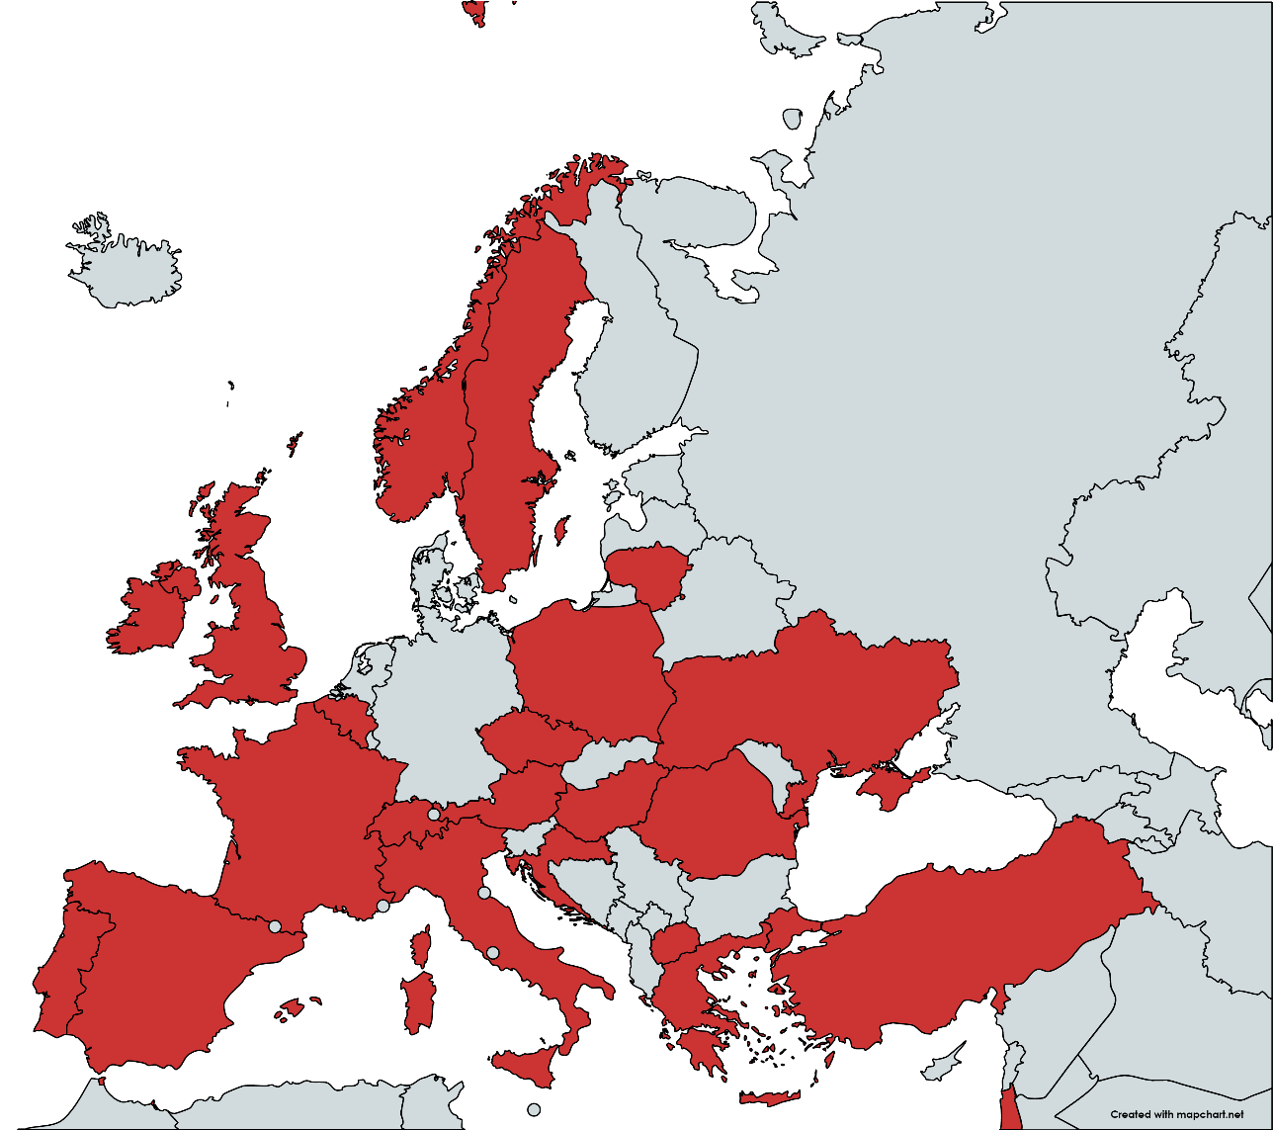
What are the current needs in Europe?
ESDN Obesity is running a follow up survey collecting guidelines for the 2016-2021 period
Currently >13 countries have participated (NDAs)
>90 individual answers from dieticians

Slide 27
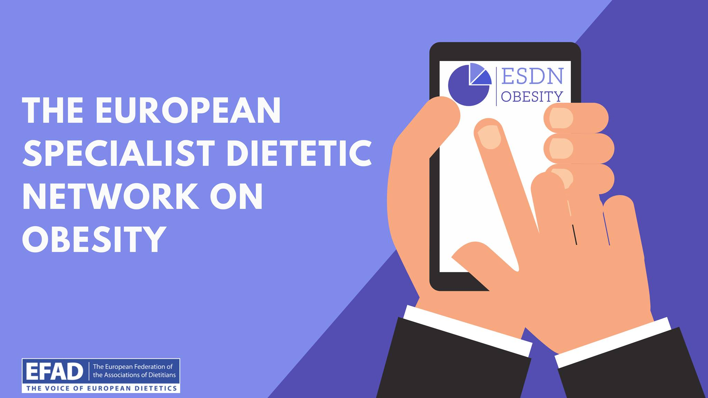
Future Steps
Production of the EFAD/EASO guidelines on the dietetic treatment of obesity
Expansion to childhood obesity
Creation of a European network of Obesity Dieticians
https://www.facebook.com/groups/httpwww.efad.orgenusspecialistsnetworksobe
The 2021 survey is still running!!!
https://buff.ly/3ted5rK

