Slide 1
How do dietitians treat obesity in Europe, the current landscape
Survey
Ellen Govers, RD, NWG (Nutrition working group EASO/EFAD)

Slide 2
Nutrition Working Group
What is the NWG
Commitment for Platform Diet, Physical Activity and Health
Phase 1: FBDG for obese adults (2016-17)
Phase 2: FBDG for obese children (2018)

Slide 3
EFAD Association Members
EFAD has 34 National Dietetic
Association members
in 27 European countries
representing almost
34,000 dietitians

Slide 4
European Specialist Dietetic Network
EFAD has 8 ESDNs with 47 experts in
Obesity
Older Adult
Diabetes
Public Health
Food Service
Oncology
Primary care
Education

Slide 5
Programme
Why a questionnaire?
Outcomes
Conclusions

Slide 6
Why a questionnaire
The first questionnaire had little response.
We had no insight in the methods and knowledge of dietitians treating obesity.
Dietitians are a valuable source of expertise in the management of obesity which should be used to increase the quality of interventions applied in all centers where obese patients are treated.
The aim of the survey was to identify best practice by dietitians in terms of dietary intervention and to improve quality and evidence based care.
Mapping gives additional information for development of FBDG for obese adults & children (phase 1 and 2).

Slide 7
Methods
First questionnaire to COM’s (2016)
Same questionnaire + some more questions through EFAD secretariat (survey monkey) to all member associations
Responses collected, december 2016
Analyses by ESDN Obesity

Slide 8
Outcomes
229 questionnaires were returned, of which 44 questionnaires were not fit for analysis.
Exclusion criteria: absence of general information (work setting and country).
185 questionnaires were used for the analysis.

Slide 9
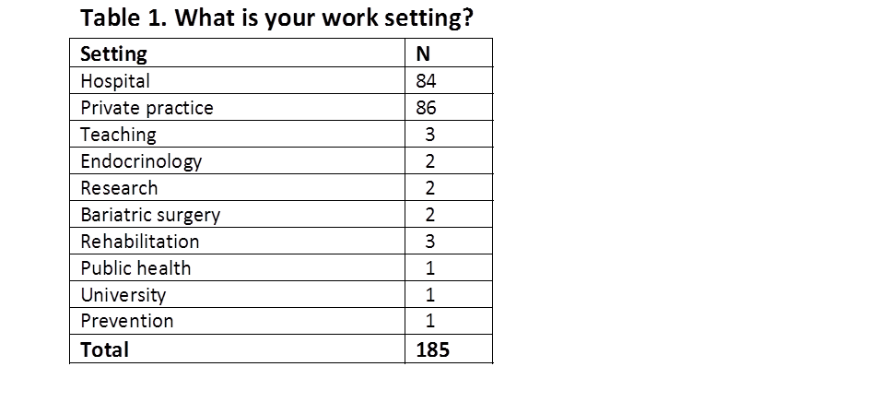
General information about the practice

Slide 18
H. In your opinion what are the main barriers to diet adherence? Name the three most important
No frequent contact with the dietitian;
Lack of time;
Lack of motivation;
Sedentary lifestyle;
Family and friends;
Not having a proper lunch break;
Lack of knowledge;
Physiologically increased hunger and decreased satiety;
Do not weigh foods anymore;
Underestimate energy content in foods and overestimate energy expended by physical activity;
Fast Food;
Alcoholic Drinks;
Food frequency;
Psychological factors;
Medical condition;
Habits;
Financial problems;
Decrease of disturbed eating behaviour and obsessive thinking about foods;
Restrictive eating in itself;
Lack of awareness about inner physical cues;
Lack of adequate coping styles with stress or negative affect .

Slide 20
Dietitians specialised in obesity:
The majority work in a multi disciplinary team
Have followed additional training
Are 33%Bsc; 16% masters; 5% Phd
Have a mean of 24 years of experience
76% work according to national guidelines
60% also have a specific guideline for obese children
70% treat patients based on dietary assessment
88% use other diets additional to diet assessment

Slide 21
Points for evaluation
No sharp targets for weight loss and weight maintenance
More emphasis on quality of life as weight loss outcome than on weight loss
Waist circumference is not measured by 30%
Objectives for weight loss management seem not clear for many

